Slide 1
Lecture 15: More on Methods
Reading: Chapter 6, 6.3 - 6.5, 6.7 - 6.10

Slide 2
Review of Methods
Methods have modifiers. For this class, you will always use public static.
Methods have return types: void, int, double, etc...
Methods that return something need a return statement at the very end of the method.
Methods have parameters. These are values that you can pass into the method that can be stored in the parameter names and used by the method. You must specify the parameter type.
In order to use a method, you must call or invoke it by using the method name, parentheses, and any needed parameters.
Primitive type variables in different methods do NOT talk to each other. What happens in Vegas, stays in Vegas.

Slide 3
Example: Void method
public class Example
{
public static void main(String[] args)
{
System.out.print(“The grade is ”);
printGrade(78.5);
System.out.print(“The grade is ”);
printGrade(59.5);
}
public static void printGrade(double score)
{
if (score >= 90.0)
System.out.println(‘A’);
else if (score >= 80.0)
System.out.println(‘B’);
else if (score >= 70.0)
System.out.println(‘C’);
else if (score >= 60.0)
System.out.println(‘D’);
else
System.out.println(‘F’);
}
}
Because printGrade is a void method, you do not need a return statement.
Because printGrade does not return a value, you do not need to assign it to a variable or do calculations with it. You can just invoke it.

Slide 4
Example: Method that returns a char value
public class Example
{
public static void main(String[] args)
{
System.out.println(“The grade is ” + getGrade(78.5));
System.out.println(“The grade is ” + getGrade(59.5));
}
public static char getGrade(double score)
{
if (score >= 90.0)
return ‘A’;
else if (score >= 80.0)
return ‘B’;
else if (score >= 70.0)
return ‘C’;
else if (score >= 60.0)
return ‘D’;
else
return ‘E’;
}
}
Output Window
The grade is C
The grade is E
Memory (main)
getGrade(78.5)
getGrade(59.5)
C
E
Memory (getGrade)
score: 78.5
Memory (getGrade)
score: 59.5

Slide 5
Example: Method that has different types of parameters
public class Example
{
public static void main(String[] args)
{
System.out.print(“1 + 1.5 is ” + addIntToDecimal(1, 1.5));
System.out.print(“1 + 1.5 is ” + addIntToDecimal(1.5, 1));
}
public static double addIntToDecimal(int num1, double num2)
{
return num1 + num2;
}
}
1.5 is not an int! You must match types!
The order of parameters matters!!

Slide 6
Example: Passing by value
public class Example
{
public static void main(String[] args)
{
double grade1 = 78.5;
System.out.println(“The grade is ” + getGrade(grade1));
double grade2 = 59.5;
System.out.println(“The grade is ” + getGrade(grade2));
}
public static char getGrade(double score)
{
if (score >= 90.0)
return ‘A’;
else if (score >= 80.0)
return ‘B’;
else if (score >= 70.0)
return ‘C’;
else if (score >= 60.0)
return ‘D’;
else
return ‘E’;
}
}
Output Window
The grade is C
The grade is E
Memory (main)
grade1: 78.5
getGrade(grade1) ⇒ getGrade(78.5)
grade2: 59.5
getGrade(grade2) ⇒ getGrade(59.5)
C
E
Memory (getGrade)
score: 78.5
Memory (getGrade)
score: 59.5

Slide 7
Example: Passing by value
public class Example
{
public static void main(String[] args)
{
String first = “Happy”;
String second = “Birthday”;
System.out.println(“The combined words are: ” + combineStrings(first, second));
System.out.println(“The combined words are: ” + combineStringsTwo(first, second));
}
public static String combineStrings(String first, String second)
{
return first + second;
}
public static String combineStringsTwo(String first, String second)
{
String newString = first + second;
return newString;
}
}

Slide 8
Methods can call/invoke other methods
public class Example
{
public static void main(String[] args)
{
int num1 = 5;
int num2 = 7;
System.out.println(“5 + 7 is ” + add(num1, num2));
System.out.println(“7 - 5 is ” + subtract(num2, num1));
}
public static int add(int num1, int num2)
{
return num1 + num2;
}
public static int subtract(int num1, int num2)
{
return add(num1, -1 * num2);
}
}
Output Window
5 + 7 is 12
7 - 5 is 2
Memory (main)
num1: 5
num2: 7
add(num1, num2) ⇒ add(5, 7)
subtract(num2, num1) ⇒ subtract(7, 5)
12
2
Memory (subtract)
num1: 7
num2: 5
add(num1, -num2) ⇒ add(7, -5)
Memory (add)
num1: 5
num2: 7
2
Memory (add)
num1: 7
num2: -5

Slide 9
Example
A pentagonal number is defined as n(3n – 1)/2 for n = 1, 2, . . ., and so on. Therefore,
the first few numbers are 1, 5, 12, 22, . . . . Write a method with the following header
that returns a pentagonal number:
public static int getPentagonalNumber(int n)
Use your method to print out the first 100 pentagonal numbers with only 10 numbers
per line.

Slide 10
public class PentagonalNumbers
{
public static void main(String[] args)
{
for (int i = 1; i <= 100; i++)
{
if (i % 10 == 0)
System.out.println(getPentagonalNumber(i));
else
System.out.print(getPentagonalNumber(i) + “ ”);
}
}
public static int getPentagonalNumber(int n)
{
int penta = (n * (3 * n - 1))/2;
return penta;
}
}

Slide 11
Example
Write a method with the following header that prints out a row of asterisks of length n.
public static void printRow(int n)
Use your row method to make another method with the following header that prints
out a rectangle of asterisks of m rows and n columns.
public static void printRectangle(int m, int n)
In the main method, ask the user to enter a value for m and a value for n. Use your
rectangle method in the main method to print out a rectangle of m rows and n
columns.

Slide 12
import java.util.Scanner;
public class Rectangle
{
public static void main(String[] args)
{
Scanner kb = new Scanner(System.in);
System.out.println(“Enter m: ”);
int m = kb.nextInt();
System.out.println(“Enter n: ”);
int n = kb.nextInt();
printRectangle(m, n);
}
public static void printRow(int n)
{
for (int i = 1; i <= n; i++)
{
System.out.print(“*”);
}
}
public static void printRectangle(int m, int n)
{
for (int i = 1; i <= m; i++)
{
printRow(n);
System.out.println();
}
}
}

Slide 13
Midterm
Midterm solutions will be posted within the next week.
I will go over the coding problems in class.
I am happy to work through any of the problems on the midterm with you during my office hours.
Any requests for re-grading (with the exception of any arithmetic errors in totaling points) MUST be in writing (i.e. NOT via email).
If you submit a request for a re-grade, I will re-grade the entire exam. This does not necessarily mean that your score will increase. It means that I will re-grade every problem to determine whether I agree with my original grading. Your score could decrease, increase or remain the same.
All re-grade requests must be submitted within 48 hours of receiving your exam.
Notes:
Everyone look at problem #5 or #7 (base conversion)

Slide 14
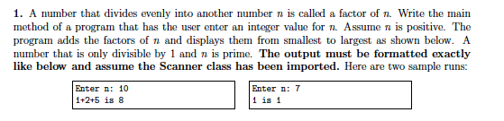
Midterm #1(a)

Slide 15
public static void main(String[] args)
{
int n;
System.out.print("Enter n: ");
n = kb.nextInt();
int sum = 0;
for (int i = 1; i < n; i++)
{
if (n % i == 0)
{
if (i == 1)
System.out.print(i);
else
System.out.print(“+” + i);
sum += i;
}
}
System.out.println(" is " + sum);
}

Slide 16
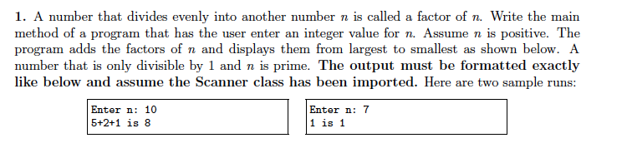
Midterm #1(b)

Slide 17
public static void main(String[] args)
{
int n;
System.out.print("Enter n: ");
n = kb.nextInt();
int sum = 0;
for (int i = n - 1; i >= 1; i--)
{
if (n % i == 0)
{
if (i == 1)
System.out.print(i);
else
System.out.print(i + "+");
sum += i;
}
}
System.out.println(" is " + sum);
}

Slide 18
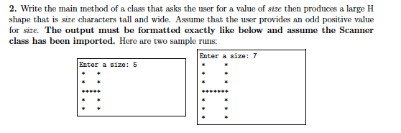
Midterm #2(a)

Slide 19
public static void main(String[] args)
{
int size;
System.out.print("Enter n: ");
n = kb.nextInt();
for (int row = 1; row <= size; row++)
{
for (int col = 1; col <= size; col++)
{
if (col == 1 || col == size)
System.out.print("*");
else if (row == size/2 + 1)
System.out.print("*");
else
System.out.print(" ");
}
System.out.println();
}
}

Slide 20
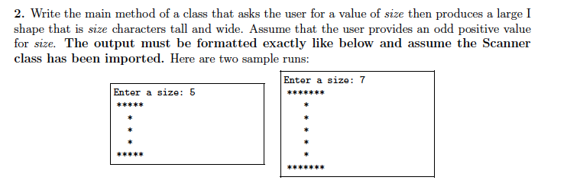
Midterm #2(b)

Slide 21
public static void main(String[] args)
{
int size;
System.out.print("Enter n: ");
n = kb.nextInt();
for (int row = 1; row <= size; row++)
{
for (int col = 1; col <= size; col++)
{
if (row == 1 || row == size)
System.out.print("*");
else if (col == size/2 + 1)
System.out.print("*");
else
System.out.print(" ");
}
System.out.println();
}
}

Slide 22
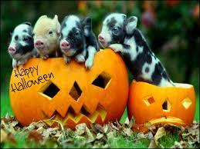
Read Sections 6.3 - 6.5, 6.7 - 6.10
Homework #6 is posted on the course website
and is due Wednesday, November 5th.

